Slide 1
FOOT AND HOOF INJURIES: A REVIEW FROM WOUNDS TO FRACTURES
Cathleen Mochal-King DVM, MS, DACVS-LA, Terri Nusz Endowed Professor of Equine Surgery
Mississippi State University College of Veterinary Medicine

Slide 2
Emergencies of the Equine foot and Distal limb
1. Heel Bulb/ Distal Limb Lacerations
2. Puncture Wounds to Sole/ Distal Limb
3. Septic Arthritis/ Tenosynovitis
4. Fractures of the Distal Phalanx
5. Navicular Bone Fractures

Slide 3
LACERATIONS OF THE HOOF AND LOWER LIMB

Slide 4
HEEL BULB & LACERATIONS OF THE LOWER LIMB
Very common traumatic injuries to the foot and distal limb
Result from
over-reaching accidents
encounters with fencing
Severe hemorrhage may occur with trauma to the digital veins and arteries
Lameness may be minimal to severe, depending on the structures involved

Slide 5
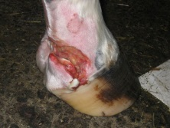
LACERATIONS OF THE HOOF AND LOWER LIMB
Frustrating to manage at times
Only way to go: Foot Cast
Prognosis Generally Good
Poor prognosis with laceration of both digital arteries

Slide 6
DIAGNOSITICS:
Advanced diagnostics are generally not required as the extent of the wound is apparent on presentation
Palpation and probing of the wound
Determine if there is involvement of a synovial structure such as the coffin joint or the digital tendon sheath
Ultrasound to determine the patency of the digital veins

Slide 7
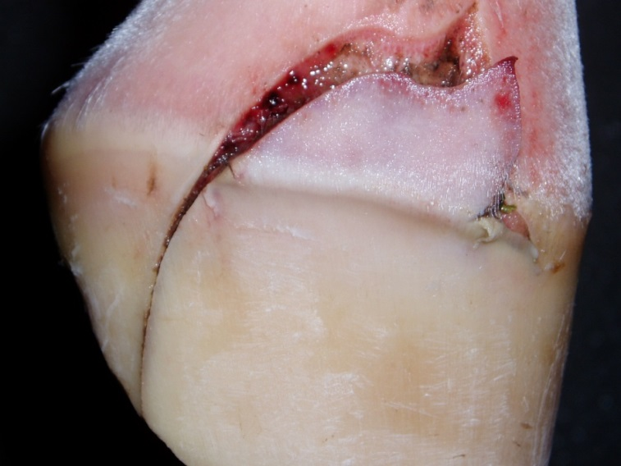
TREATMENT
Lacerations involving synovial structures refer to a surgical facility
Can be frustrating
Result in excessive granulation tissue
High motion requires a long treatment
Poor cosmetic results
Management with a hoof cast improves:
Cosmesis
Reduces treatment time
Good owner compliance.

Slide 8
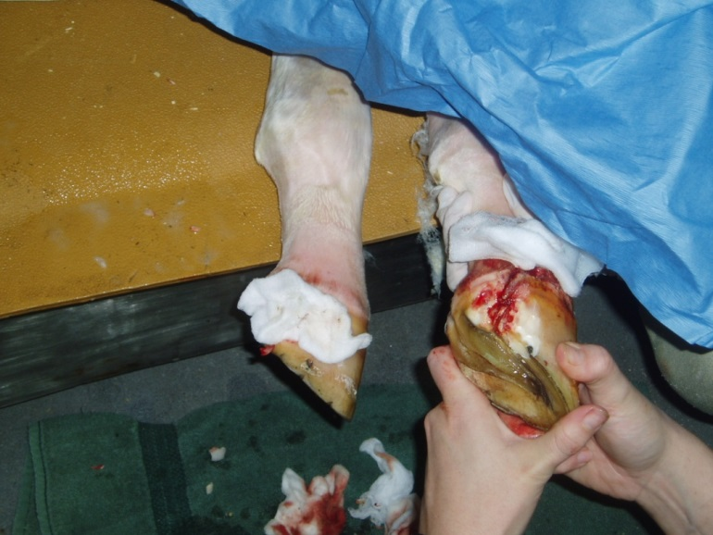
Wound Management
Thoroughly lavage with balanced electrolyte solutions
Debride the Wound
Pul-vac
Curettage
Suture everything you can!!
Don’t worry about duration of time of the wound, close everything

Slide 9
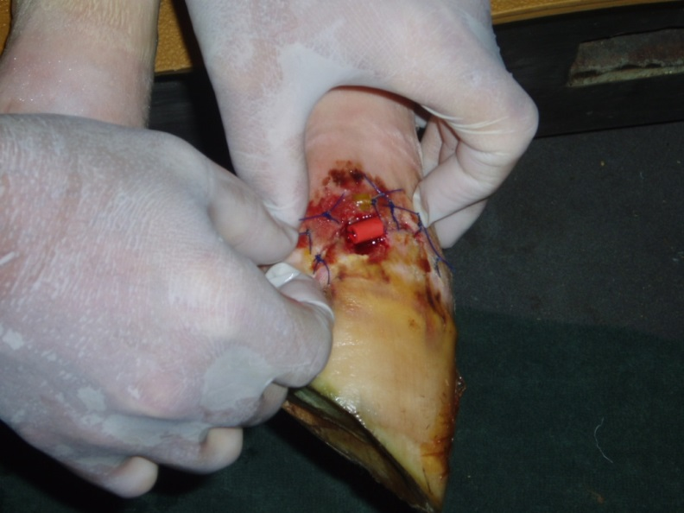
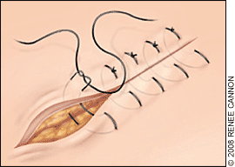
Treatment: Suturing
Resect granulation tissue and perform a delayed closure
Suture material
Large
1-3 Vicryl
1-2 PDS
Suture patter
Vertical Mattress
Perpendicular to incision
Horizontal Mattress
Parallel to incision (must use stints to protect blood supply)

Slide 10
Wound Management
Apply silver sulfadiazine cream or triple antibiotic ointment and a non-adherent dressing to any unopposed tissue.
Place in a hoof cast
Confine to a stall for 14 days.
Remove the cast and sutures after 14 days
Antimicrobial therapy is recommended for 7-10 days
NSAIDS for 5 days to minimize swelling within the cast

Slide 11
PUNCTURE WOUNDS TO THE HOOF AND LOWER LIMB

Slide 12
PUNCTURE WOUNDS TO THE HOOF AND LOWER LIMB
Barn yards are littered with metallic foreign materials ranging from wood nails to fencing that make excellent foreign bodies for the equine distal limb.
Penetrating foreign bodies are contaminated with:
Dirt
Fecal material
Rust
The wound seals quickly
No area for drainage
Leads to the development of an anaerobic environment
At risk for the growth of Clostridium tetani

Slide 13
PUNCTURE WOUNDS TO THE HOOF AND LOWER LIMB
Inadvertent injury to the distal phalanx, distal sesamoid, navicular bursa, and digital tendon sheath
Deep puncture wounds must be treated as an emergency to prevent the infection of bones, joints, and tendon sheaths
Referral is recommended for synovial structure involvement
Goals: To prevent septic arthritis, septic tenosynovitis, or septic pedal osteitis

Slide 14
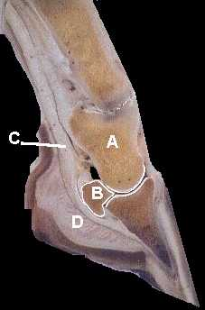
Anatomy
P2
Navicular Bone
Coffin Joint
DDFT
Digital Cushion
P3

Slide 15
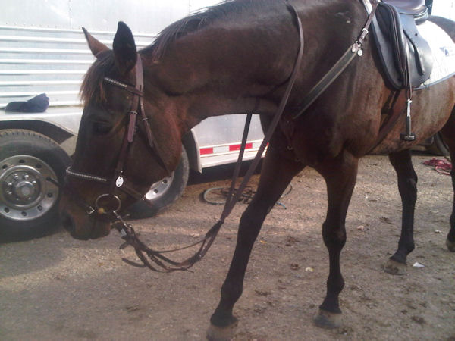
Clinical signs
Acute lameness ranging in severity from non-weight bearing to significant lameness at the walk.
Increased digital pulses
Examination with hoof testers usually elicits severe pain

Slide 16
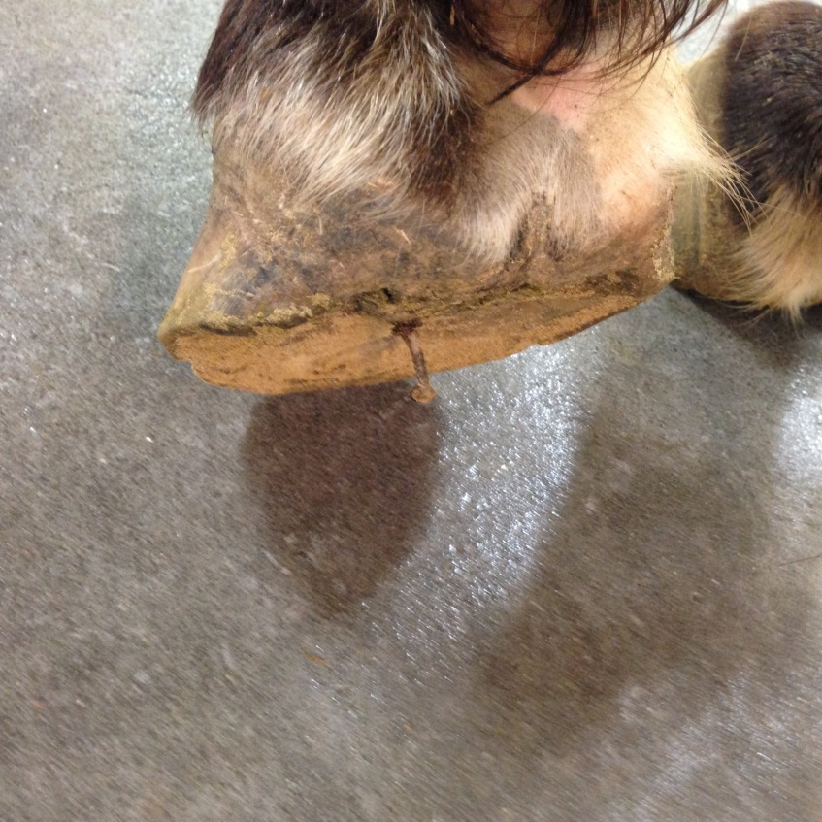
Diagnostics
Strongly recommended to leave the foreign body in place until baseline radiographs are taken to evaluate deeper structure involvement
Once removed the superficial wound closes rapidly
Can be difficult to fully evaluate once closed
Remove after completion of the initial radiographs

Slide 17
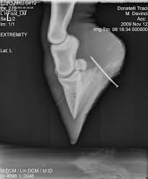
Diagnostic
Perform baseline radiographs first looking for a gas shadow
Contrast radiography in the form of an arthrogram or fistulogram will be beneficial for diagnosing deeper structure involvement. In the event that the foreign body has been removed,

Slide 18
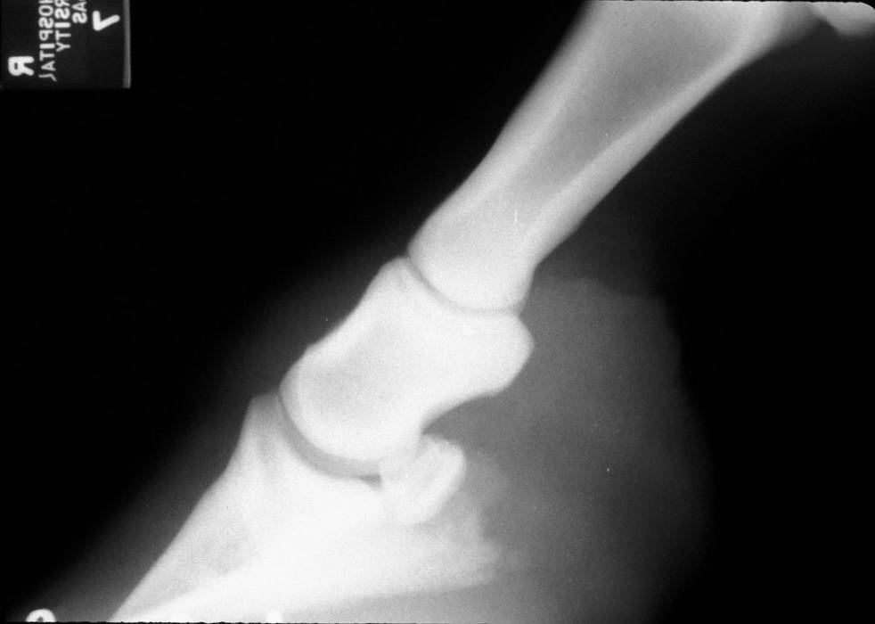
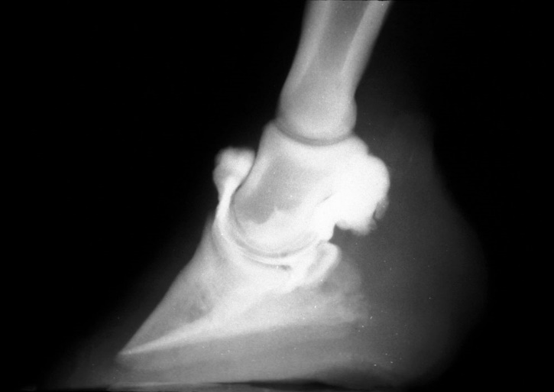
Diagnostics: Fistulogram- using contrast to determine the extent of the wound
Utilize adequate standing sedation
Aseptically prepare the wound
With sterile gloves place a 14 gauge myelocatheter without the stylet into the wound tract
Following catheter placement inject 15-20ml of sterile Reno-cal-76®
It is preferred to use the denser Iodine product at 37% verses other products at 20% iodine like isovue-m ®200

Slide 19
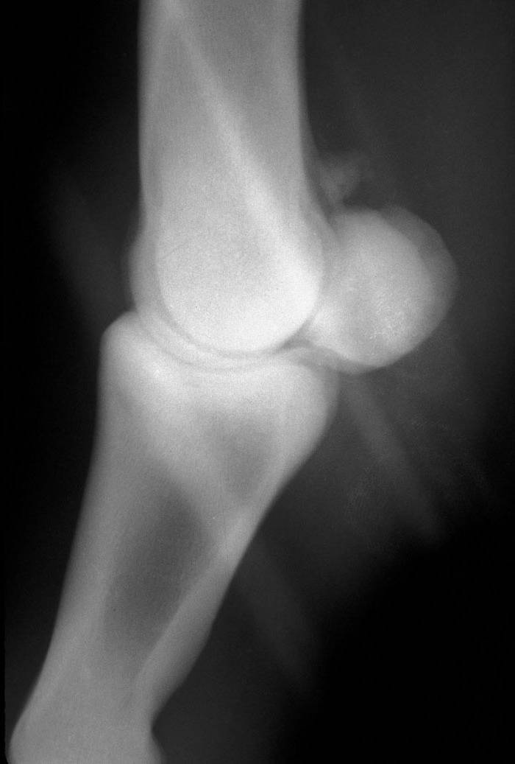
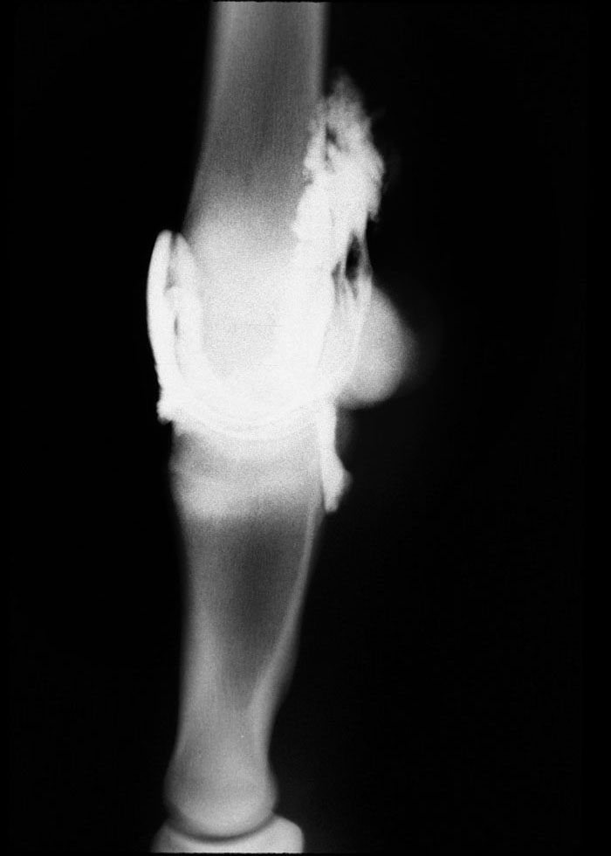
Diagnostics: Arthrogram
Sterilely prep the joint for arthrocentesis.
Utilizing sterile technique place 20 gauge needle into the joint space
Collect joint fluid for cytology and culture prior to injecting the contrast
Inject 10-20 mls of iodinated contrast into the joint.
Following addition of the contrast evaluate the wound for presence of contrast
Manipulate the joint or walk the horse to disperse the contrast agent

Slide 20
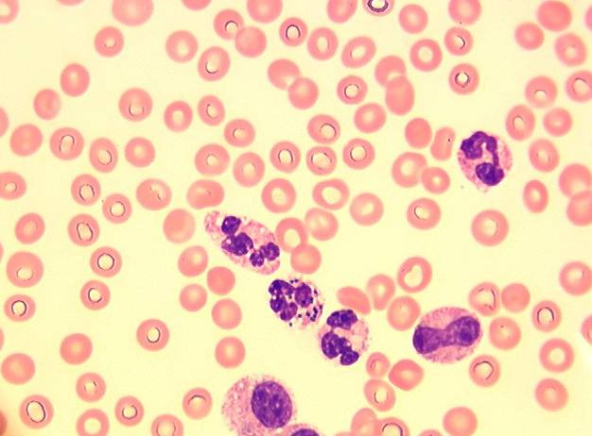
Cytology
Cytology is very helpful in initially determining if the joint is septic
Monitor the progress of treatment
Difficult to see bacteria on synovial fluid slides
WBC are very important for determining if a synovial structure is infected
When in doubt, err on the side of caution!

Slide 21
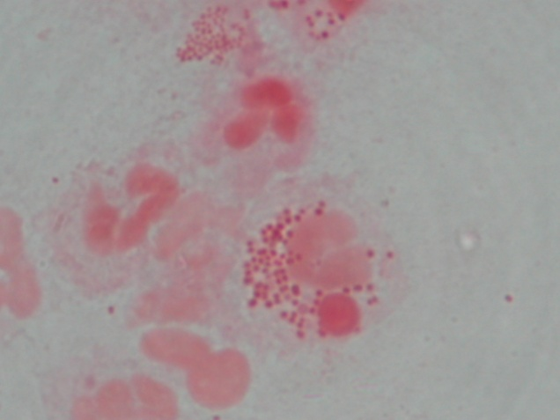
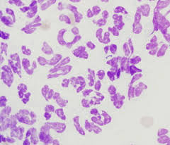
Cytology
Synovial fluid analysis in sepsis
A high protein concentration (>2.5 g/dl)
High leukocyte count (normal<5 to 10,000)
Classically in foals exceed 30,000 cells/uL,
Greater than 90% neutrophils
Neutrophils are rarely degenerate
Gram stains rarely reveal the etiologic agent
Serial analyses to monitor progress

Slide 22
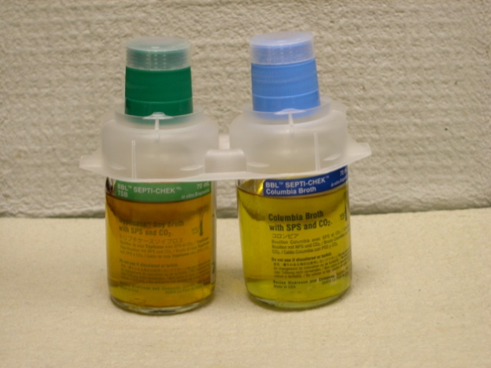
Culture and Sensitivity
Culture the synovial fluid in blood culture bottles
Culture will only be successful in isolating bacteria in 25% of cases
Synovial biopsies will significantly increase the likelihood of identification of the organism
Bacterial isolation increases to 50%
Febrile animals should also have a “true” blood culture

Slide 23

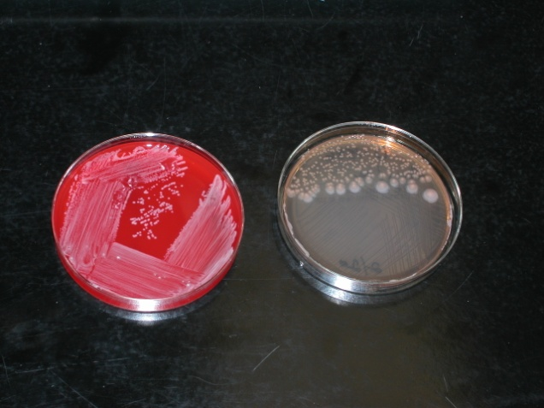
Bacterial isolates
Most common organisms in Horses are:
Gram-positive: Strep sp and Staph sp
Resulting from joint injections and arthroscopies
Gram-negative: E. coli
Resulting from wounds
Most common organisms isolated in Foal septic arthritis are:
Actinobacillus
E.coli
Klebsiella sp
Pseudomonas sp
Salmonella

Slide 24
Treatment for Puncture Wounds:
Sedate the horse heavily
penetrating wounds are very painful and make patient cooperation difficult
Sedation: 5mg Butorphanol with 5 mg Detomidine
Add 10 mg of Acepromazine if horse is anxious
Perform a ring block at the level of the fetlock
50% mixture of carbocaine and bupivicaine
Remove all gross contamination
Hose dirt and mud off the distal limb
Scrub the hoof with chlorhexidine
In non-metallic foreign bodies some of the sole and frog may need to be excised to remove the object

Slide 25
Treatment for Puncture Wounds:
Debride the tract until all gross debris is removed
Debride the bone aggressively with a currett
copiously lavage the wound
Apply topical antibiotics in wounds that involve only the sole, cushion, or P3
Mastitis ointments are very effective
Bandage in a heavy padded bandage with duct tape on the bottom to maintain a clean and sterile bandage

Slide 26
Treatment for Puncture Wounds:
Nonsteroidal Anti-inflammatory Drugs:
Phenylbutazone: 2.2 mg/kg orally every 12-24 hours for 7 days
Flunixin Meglumine: 1.1 mg/kg orally or IV every 12 hours for 7 days
Firocoxib: 0.1 mg/kg orally for 30 days

Slide 27
Treatment for Puncture Wounds:
Antimicrobial Therapies for Puncture Wounds not involving P3:
Trimethoprim sulfadiazine 30 mg/kg orally every 12 hours for 10 days
Minocycline 4mg/kg orally every 12 hours for 10 days
Antimicrobial Therapies for Puncture Wounds involving P3:
Trimethoprim sulfadiazine 30 mg/kg orally every 12 hours for 30 days
Minocycline 4mg/kg orally every 12 hours for 30 days.
Chloramphenicol 50 mg/kg orally every 8 hours for 30 days
Exceed (Ceftiofur) 6.6 mg/kg Intramuscular Day 1, Day 4, Day 10, Day 17, and Day 24

Slide 28
Management of Septic Arthritis or Tenosynovitis as a result of Puncture Wounds

Slide 29
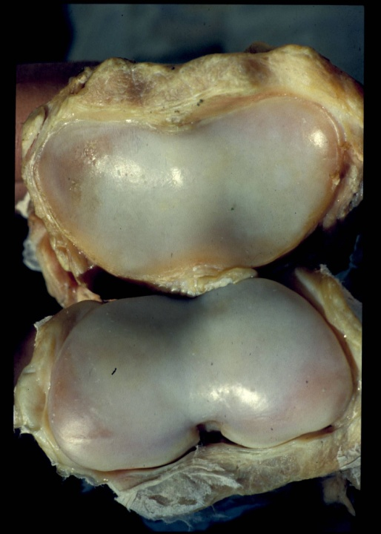
Lavage: “The Solution to Pollution is Dilution”
Absolutely must reduce the bacterial load and WBCs
Neutrophils have oxidative burst that damage cartilage
Signal for collagenase up-regulation
Poor blood flow to joints must choose drugs that have large volume of distribution
REMEMBER: THIS IS A RACE AGAINST THE DAMAGE THAT BACTERIA CAUSE

Slide 30
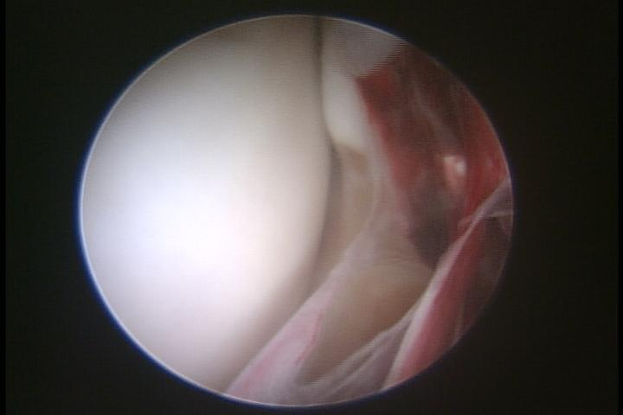
Treatment of choice: Arthroscopy
Local debridement
Removal of fibrin clots
High Volume lavage >20 liters
Difficult in pastern joint and distal tarsal joints
Repeat in several days if not improving

Slide 31
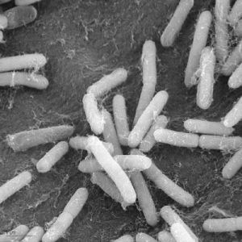
Local Treatment: Managing the Infection
Intra-articular antibiotics and Regional limb perfusions
Utilize concentration depending killing of bacteria
Use drugs that target the most common agents:
Beta lactams
Aminoglycosides
Fluoroquinolone
Chloramphenicol
Doxycycline

Slide 32
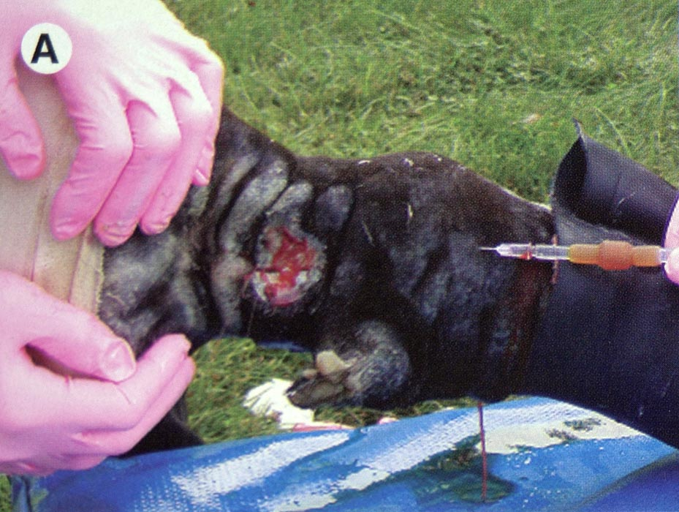
Regional limb perfusion
Excellent way to provide high concentrations of antibiotic to the distal limb
Near-total horse dose put in the leg
Novel choice of antibiotics

Slide 33
Region Limb perfusion
Previously reported synovial concentrations following regional limb perfusion at 24 hours
Amikacin low dose (250 mg): 12-214 µg/ml
= 0.25 mg/ml
Amikacin high dose (1000mg): 445-540 ± 170 µg/ml
= 0.5mg/ml
Enrofloxacin (1.5 mg/kg): 7-127 µg/ml
= 0.1mg/ml
Parra-Sanchez A. AJVR. 2006:1687-1695.
Errico JA. AJVR.2008:334-342.
Notes:
Our goal be hind choosing these antibiotics: We wanted to evaluated clinically relevant concentrations. In example those that you would find within the synovial fluid of following intra-articular injections. These concentrations of antibiotics are significantly greater then those previously studied within cell culture. One of our designs was to determine cell tolerance and cytotoxicity. Additionally we performed 10 fold dilutions to more closely mimic reported synovial fluid concentrations following regional limb perfusions. Our choice on antimicrobials were Amikacin and Enrofloxacin. Amikacin is a standard antimicrobial in management of septic arthritis as well as commonly used in prevent in intra-articular joint therapies. We choose Enrofloxacin due of it history of adverse effect on cartilage in multiples species as well as decreased proteoglycan synthesis, and previously demonstrated chondrocyte toxicity. Our hypothesis was that Enrofloxacin would successful induce inflammation that we could compare to our positive controls.
Additionally we wanted to examine at more specific indices of inflammation as well as determine a treatment that could modulate these responses.
RLP concentrations: Parra-Sanchez A. Pharmacokinetics and pharmacodynamics of Enrofloxacin and low dose Amikacin administered via regional intravenous limb perfusion in standing horses. AJVR. 2006:1687-1695.
ILRVI: Errico JA. Comparison of tow indirect techniques for local delivery of a high dose of an antimicrobial in the distal portion of forelimbs of horses.

Slide 34
Systemic Antibiotics
Must be very aggressive
Need at least 5-7 day of IV antibiotic to eliminate septicemia
Total treatment time: 4-6 weeks
Best broad spectrum
K-Penicillin 22,000IU/kg IV Q6H with Gentamicin 6.6mg/kg IVQ24H
Ceftiofur 4.4 mg/kg IVQ12H
Beware Baytril is subject to resistance if used longer then 14 days

Slide 35
Pain Management
NSAIDS
Lidocaine CRI: 0.05mg/kg/min intravenously
Butorphanol Intramuscular: 3-5 mg Q6H, don’t exceed 20 mg/24hour period
Morphine Epidural (rear limb only)
Morphine RLP: 20 mg will last up to 24 hours
GOTTA GET THE PAIN UNDERCONTROL!!!
KEY ….GET INFECTION UNDER CONTROL!!!!

Slide 36
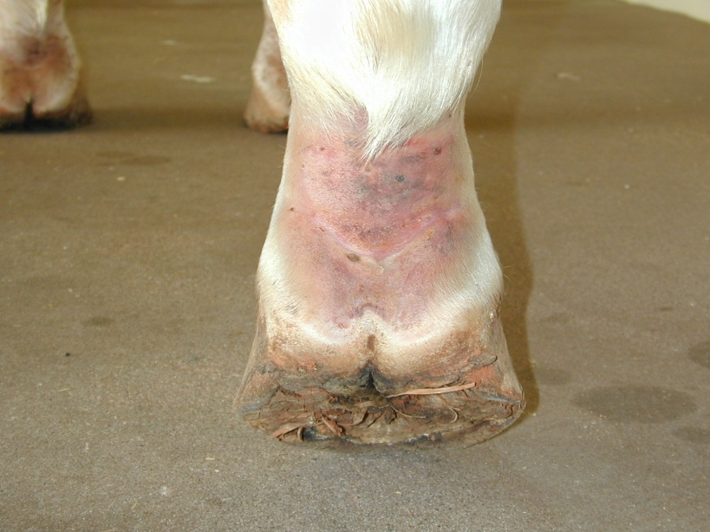
Monitor Lameness Progression
Set time limits!!!
Need to see progress in 48 hours, if not then repeat lavage and change treatment protocol
Every day that lameness does not improve increases the likelihood of poor prognosis

Slide 37
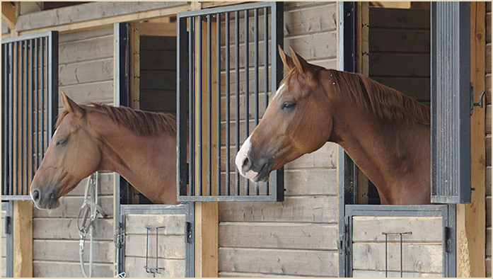
Treatment: Stall Confinement
Strict Stall Confinement!!!! Prevent further trauma
Remaining cartilage is soft until 8 weeks following resolution of the infection!
Slowly begin hand walking after infection is resolved and lameness improved

Slide 38
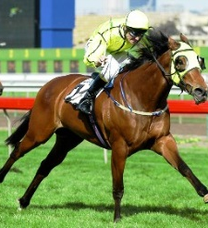
Outcome
25-50% of horses will return to full athletic performance
25% Mortality Rate
Keys to Remember:
DON’T MESS AROUND BE AGGRESSIVE IN TREATMENT !
ALWAYS TREAT AS AN EMERGENCY!

Slide 39
FRACTUES TO THE COFFIN BONE

Slide 40
Fractures to the Coffin Bone
Fractures to the coffin bone are not uncommon
They are classified as the from grade 1-7
Group A: Treatable with Return to Athletic Performance
Group B: Non-Treatable
Type 2, 3, 5
Due to their articular components and large weightbearing surface area
Difficulty to reduce and resolve lameness

Slide 41
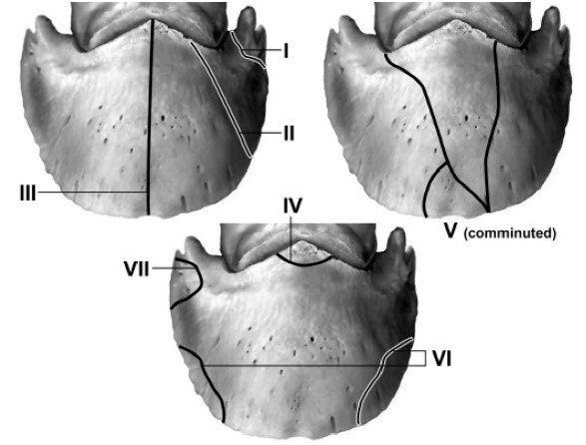

Slide 42
Diagnostics:
The diagnostic approach to these patients is a standard lameness evaluation
Significant hoof tester response across solar margin or heel
Improve with abaxial perineural anesthesia
Radiographs are the diagnostic imaging of choice
60°DP and Navicular skyline (isolates wings)
If a wing fracture to determine its significance, re-block PD on side on wing fracture.

Slide 43
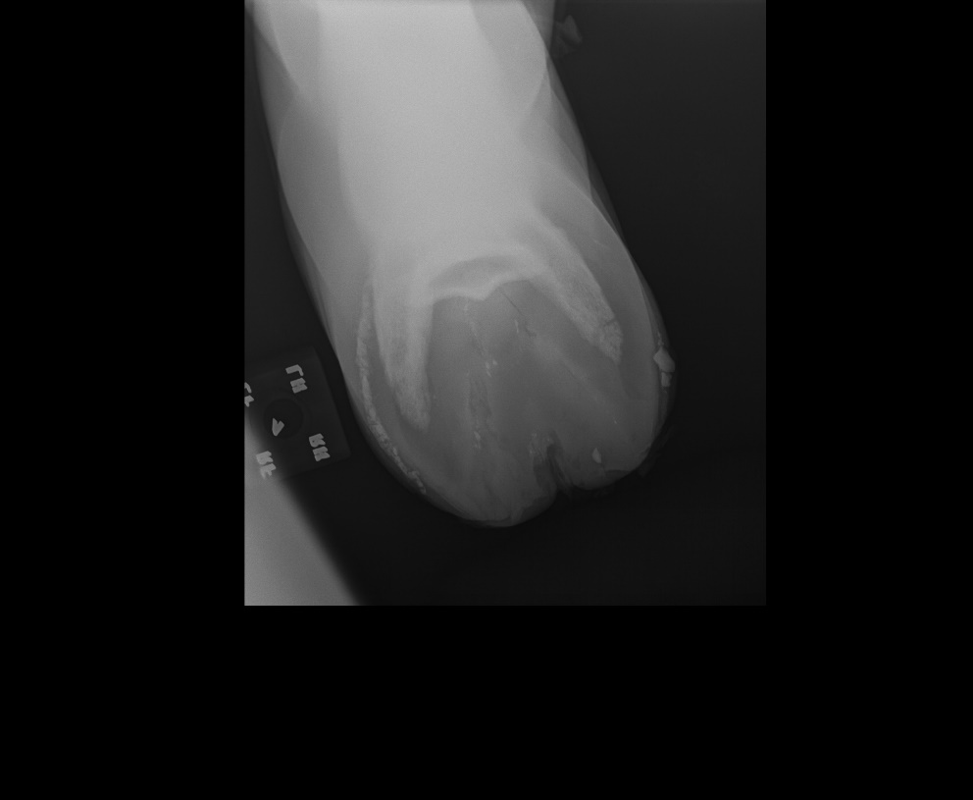
Treatable P3 fractures
Two options of treatment for wing and solar margin fractures
Shoe stabilization
Shoe with clip drawn near fragment
Pour in Packing to prevent ventral flexion
Exercise restriction for 30 days
Re-evaluate at 30 days
Surgical removal of the fragment
Sole resection with removal place in hoof cast for 30 days
Special shoeing for 6 months

Slide 44
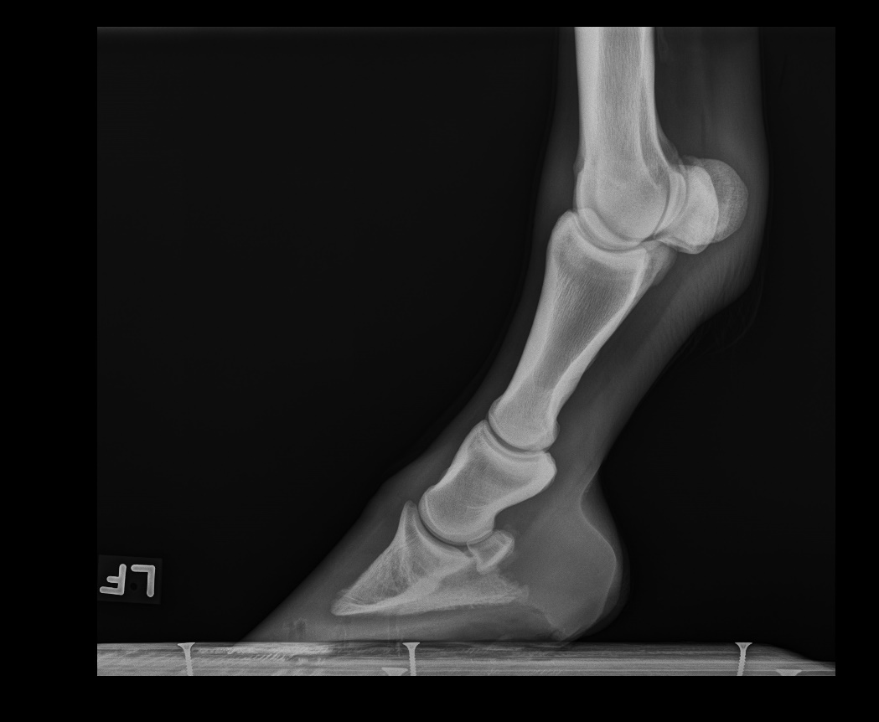
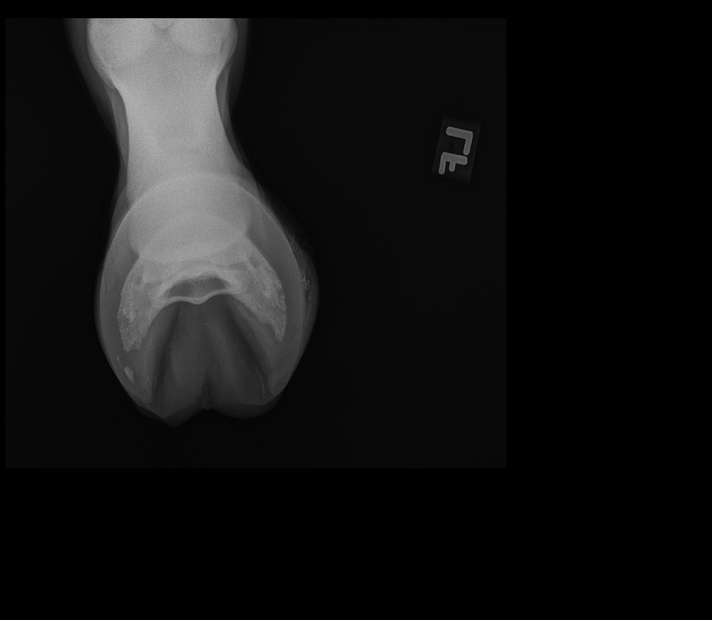
Treatable P3 Fractures

Slide 45
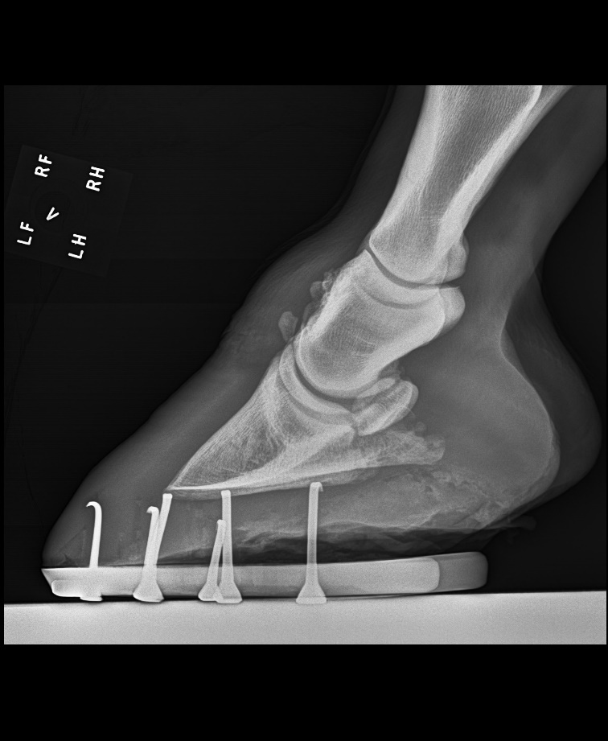
Treatable P3 fractures
Extensor Process Fractures
Three options
1. Surgical Removal
2. Internal fixation
3. Conservative Therapy

Slide 46
FRACTURES TO THE NAVICULAR BONE

Slide 47
FRACTURES TO THE NAVICULAR BONE
Navicular bone fractures are uncommon but do occur in association with navicular bone degeneration
Horses may present with varying degrees of lameness from non-weight bearing fracture lame to lameness observed at the walk

Slide 48
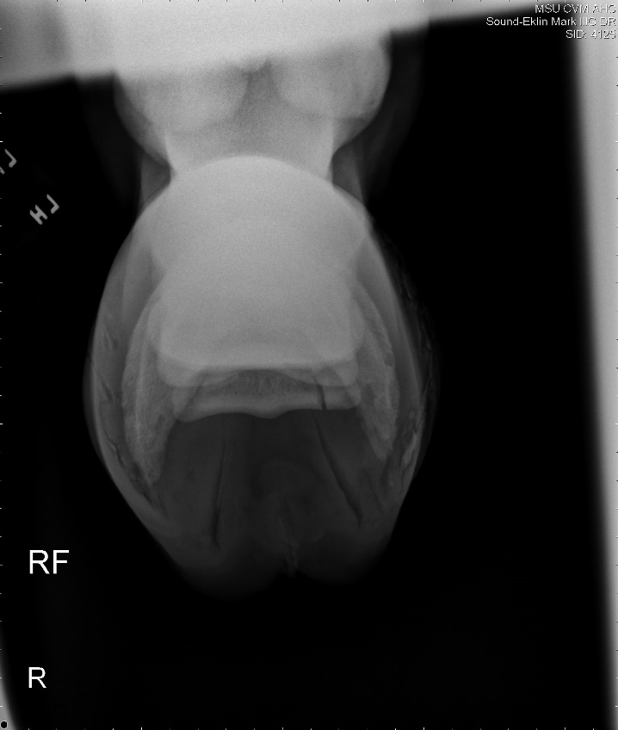
Diagnostics:
The diagnostic approach to these patients is similar to those with navicular degeneration
Significant hoof tester response across the navicular bone and heels
Improve with palmar digital perineural anesthesia
Radiographs are the diagnostic imaging of choice
60°DP
Navicular skyline

Slide 49
Treatment of Navicular Bone Fractures
Prognosis for navicular fractures is guarded to fair
Treatment of fractures is directed around structural support
The key is caudal heel support with sole compression support to minimize ventral flexion of the navicular bone.
This is achieved with heel elevation to align the dorsal cortices of the distal phalanges (P1, P2, and P3). Dorsal alignment minimizes ventral compression of P2 on the navicular.
Sole compression material needs to be filled from the ground surface of the shoe to the frog

Slide 50
Treatment of Navicular Bone Fractures
Bisphosphonates
Tildren or Osphos
Increase calcium supplementation
Stall confinement for 120 or days until recheck radiographs demonstrate resolving navicular fracture
Palmar Digital Neurectomy in unresolving lameness

Slide 51

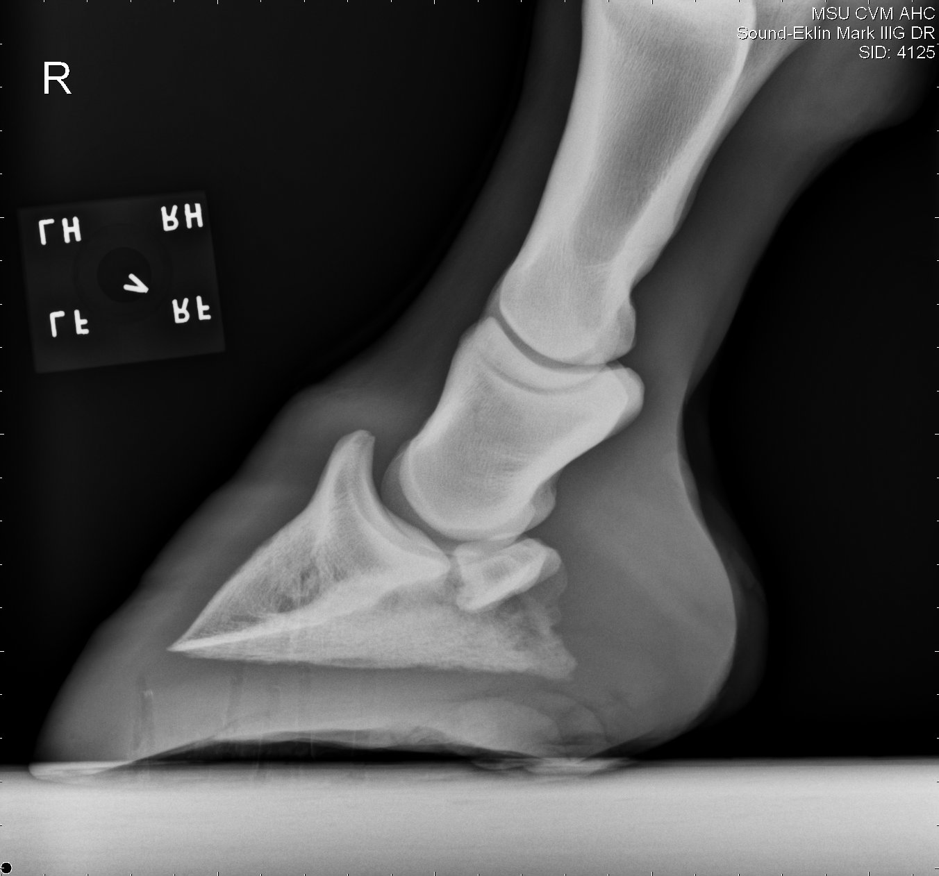
Treatment of Navicular Bone Fractures

Slide 52
Navicular Fracture Case Summary
7 Horse with Navicular Bone fractures from 2010-2018
All Quarter Horse Geldings
Age Range 7-18 yrs.
5 western pleasure, 1 roping, 1 barrel racing
Horses were grade 4/5 to 5/5 on lameness evaluation
All treated with shoeing and stall confinement

Slide 53
Navicular Fracture Case Summary
Out Come:
3 had resolution of lameness with radiographic improvement
3 improvement in lameness 1 lameness grade
2 returned to work following neurectomy
1 retired
1 euthanasia (due to support limb laminitis)

Slide 54
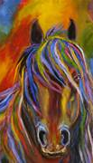
questions?

